Slide 1

Angular JS : Les directives

Slide 2
Principe et objectif des directives
Directive = attribut dans une balise de l’arbre DOM.
➔ utiliser dans le HTML
Pourquoi faire ?
Agir sur la vue
Agir sur le modèle
Appeler des fonctions JS

Slide 3
NG-CLIcK
https://docs.angularjs.org/api/ng/directive/ngClick
Permet de spécifier une fonction à appeler lorsque l’objet est cliqué.
<p ng-click="vm.update(film)">

Slide 4


NG-class
https://docs.angularjs.org/api/ng/directive/ngclass
Comportement : affecter des style à une balise
Syntax 1 : ng-class="{ myclass : aboleanVar, [myclass2 : aboleanVar2 ...]}"
Syntax 2 : ng-class = "aVarContainingTheStyle"

Slide 5
NG-Model
https://docs.angularjs.org/api/ng/directive/ngModel
ng-model : Permet de lier une variable du modèle à une balise input, select ou textarea
Comportement
Double Binding
Validation
Assigne des classes CSS (ng-valid, ng-invalid, ng-dirty, ng-pristine, ng-touched, ng-untouched, ng-empty, ng-not-empty)
<input ng-model=“user.name“ type=“text”>
Notes:
Binding the view into the model, which other directives such as input, textarea or select require.
Providing validation behavior (i.e. required, number, email, url).
Keeping the state of the control (valid/invalid, dirty/pristine, touched/untouched, validation errors).
Setting related css classes on the element (ng-valid, ng-invalid, ng-dirty, ng-pristine, ng-touched, ng-untouched, ng-empty, ng-not-empty) including animations.
Registering the control with its parent form.

Slide 6
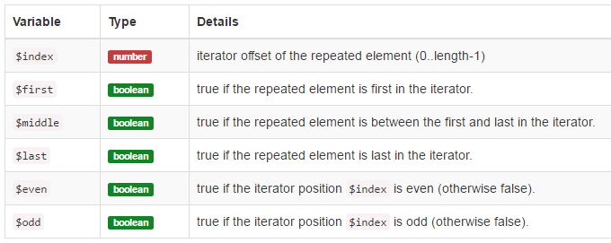
NG-Repeat
https://docs.angularjs.org/api/ng/directive/ngModel
ng-repeat : Permet de répéter le contenu d’une balise
Liste de mes amis: <ul> <li ng-repeat="friend in friends"> [{{$index + 1}}] {{friend.name}} who is {{friend.age}} years old.
</li>
</ul>

Slide 7
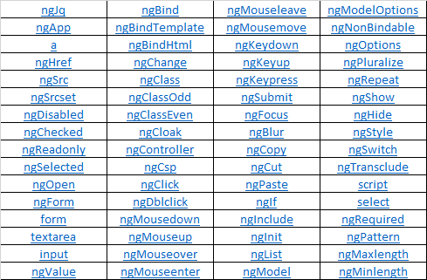
Les directives
Les 64 directives standards
https://docs.angularjs.org/api/ng/directive/

Slide 8


TODO exercise
Steps :
Init application and controlleur
Use ng-app, create a Controller
Define a var named "remaining" to a fake value ('hard code ' 5 for remaining for example) and show it in html
Define a var named "todos" and define a few tasks in it with 2 properties : title, and completed, show the title in the list on the HTML page
Apply the class #todo-list li.completed label using ng-class (add 'completed' css to the li)
Show the 'completed' property for a task and enable to toggle a task from completed true to false, and reverse to true. (checkbox) (ng-model)
Delete a task
Add a task ( add ng-submit on the <form> )
UnCompleting/Completing all tasks by clicking on the top 'v' arrow
The remaining tasks will be coded later
Notes:
use ng-class on li to make the pattern li.completed but applying class="completed" on the li
<li ng-repeat="todo in todos" ng-class="{completed: todo.completed}">

Slide 9

Directives
QUIZ
Quelle est la différence entre ?
<input type="checkbox" ng-model="master">
Et
<input type="checkbox" ng-checked="master">
Notes:
ng-checked is ONE way binding
ng-model on type=checkbox is 2-way-binding

